Slide 1


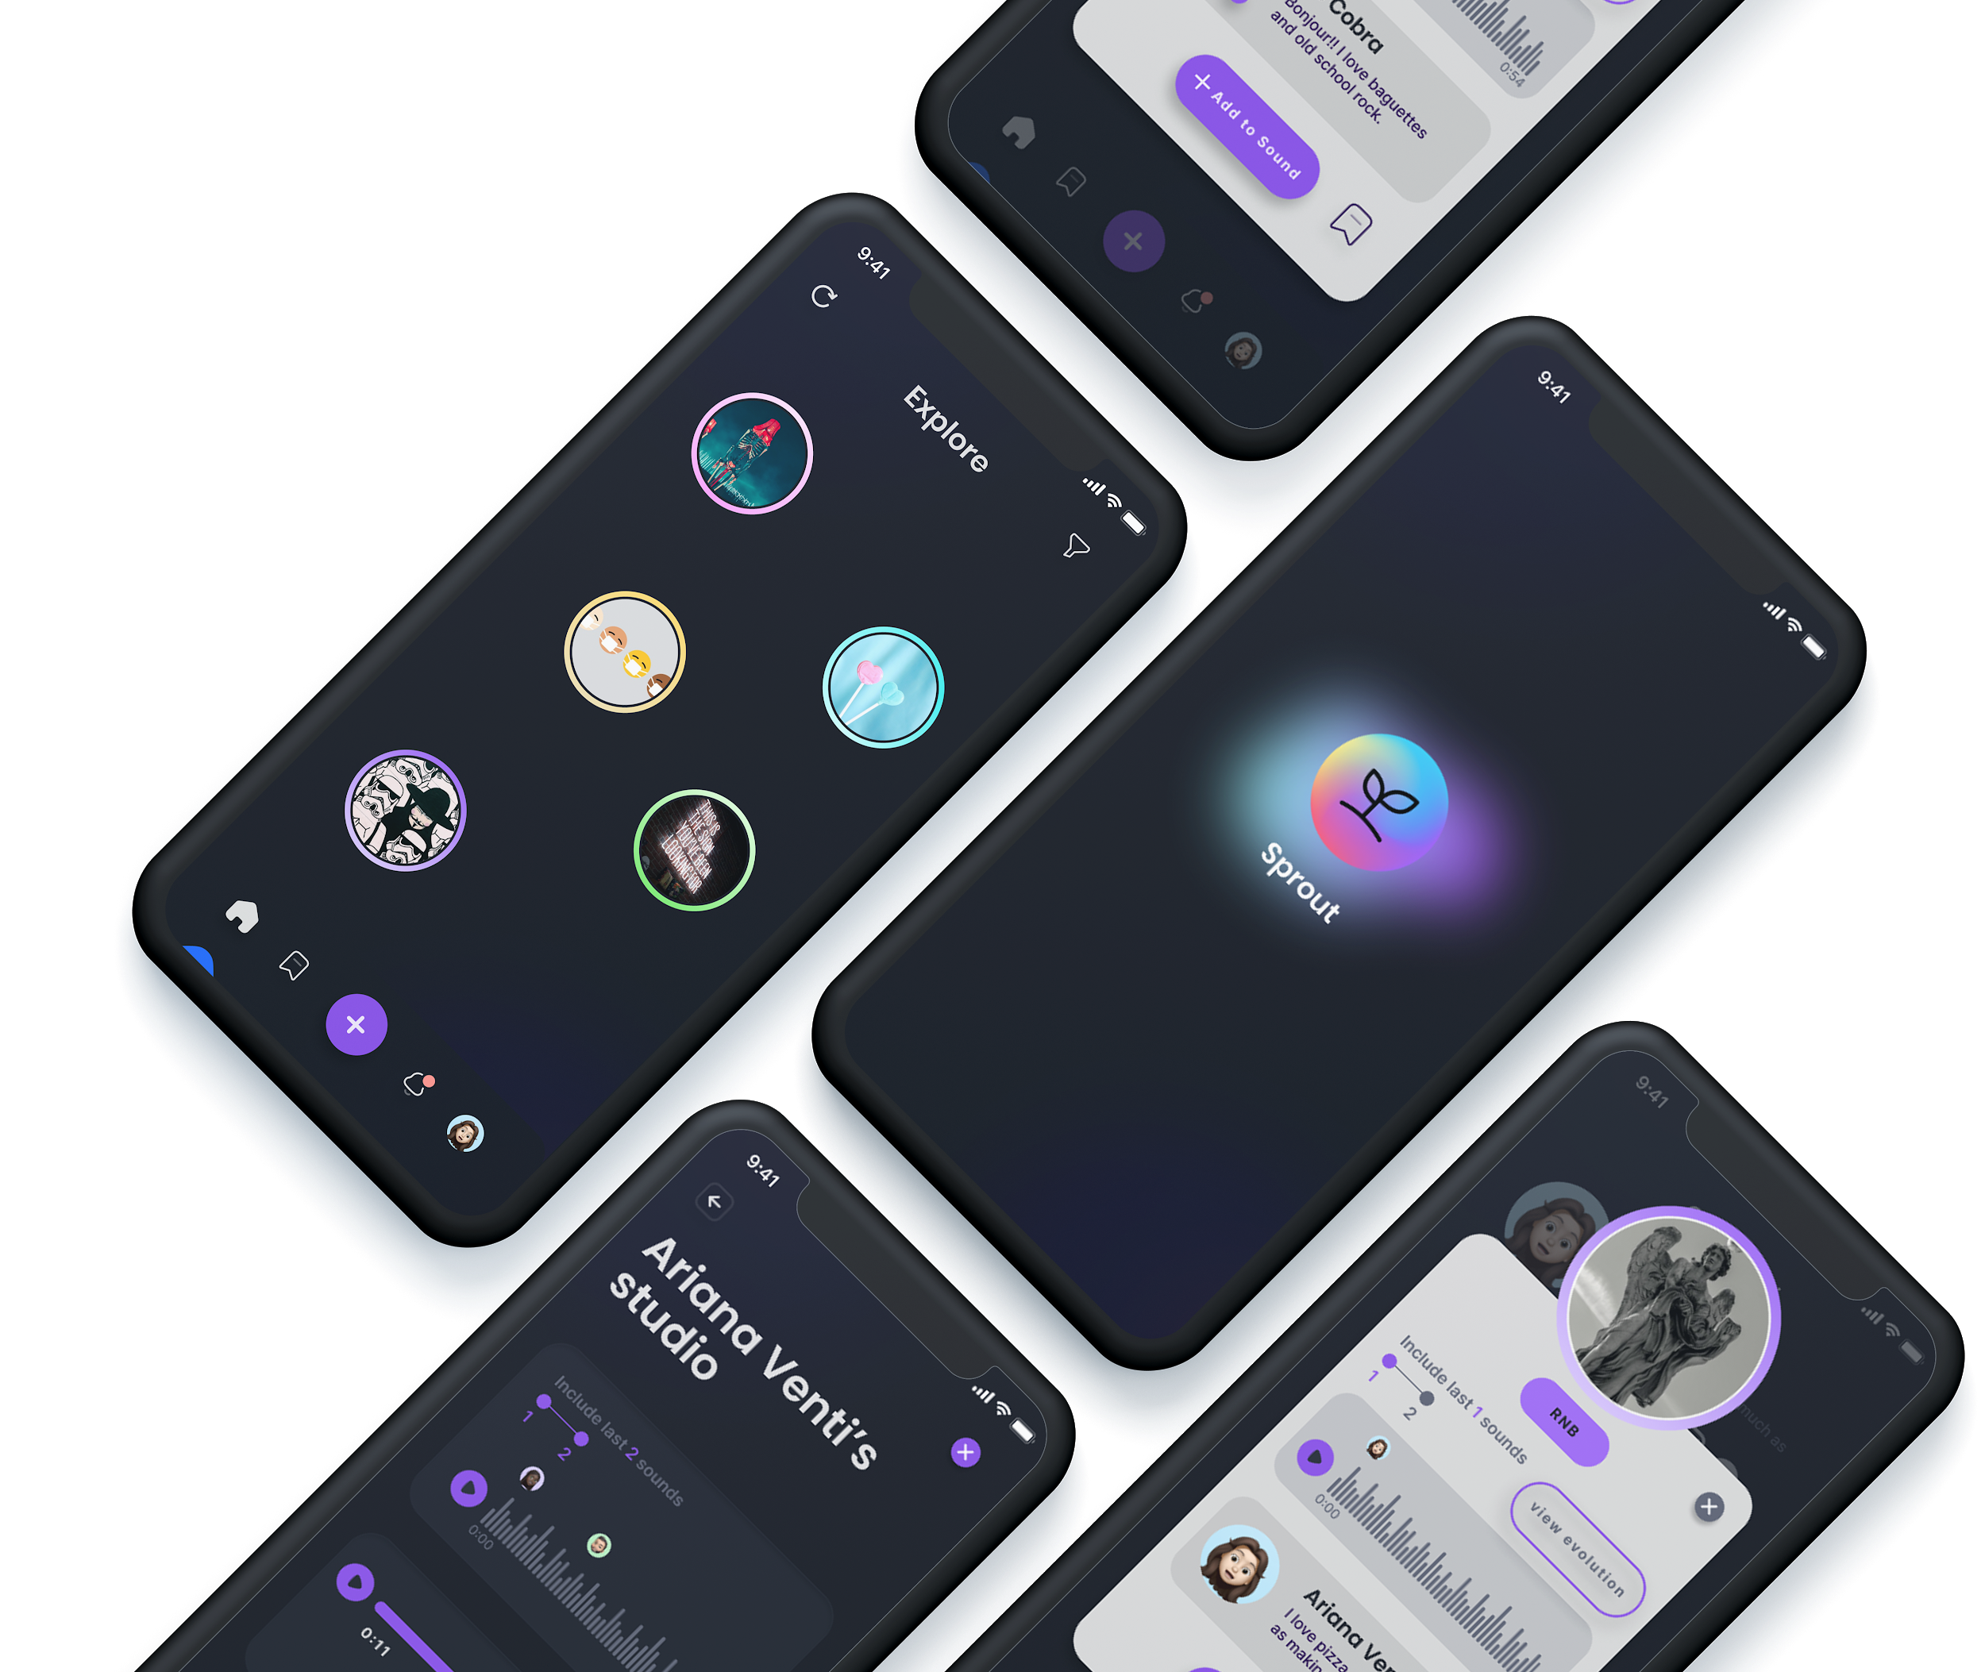

Sprout
Collaborators for an instant,
Connections for a lifetime.
ELSIE
ALIX
CONSTANCE
JIALIN

Slide 2




Growth in the music industry revolves around networking.
But networking for small creators is sparse, or awkward at best.
Sprout enables musicians to grow their network organically,
It is how creators come across breakthrough opportunities, learn from other talented artists, and expand their creative outlook.
Small creators sacrifice attending to this crucial component of their success because it feels tedious, disingenuous, “like a means to an end.”
By centering connections around short and fun musical additions to each other’s soundbytes.
Notes:
Problem & solution overview

Slide 3




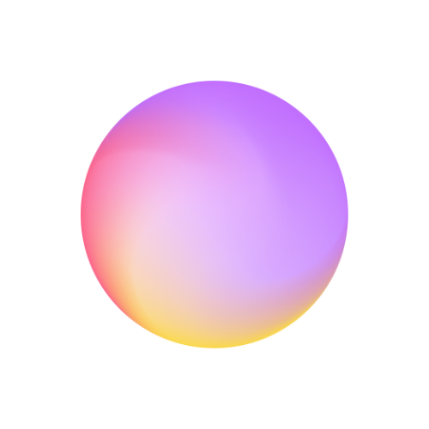

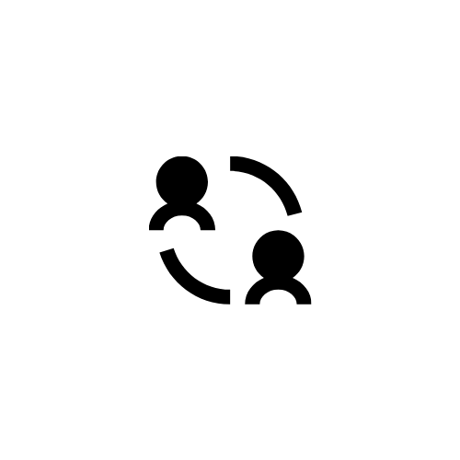


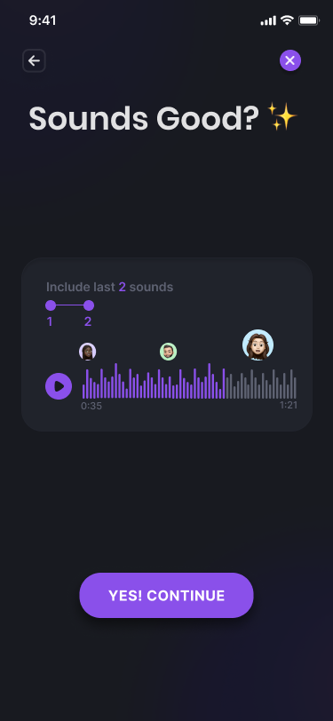
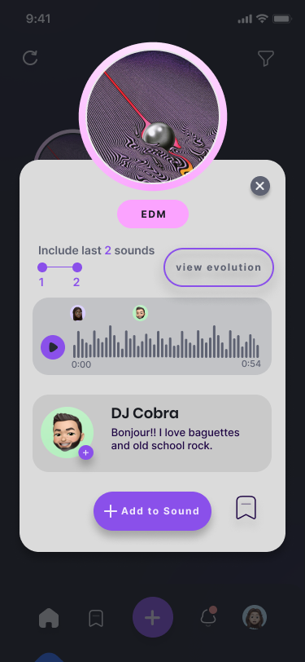
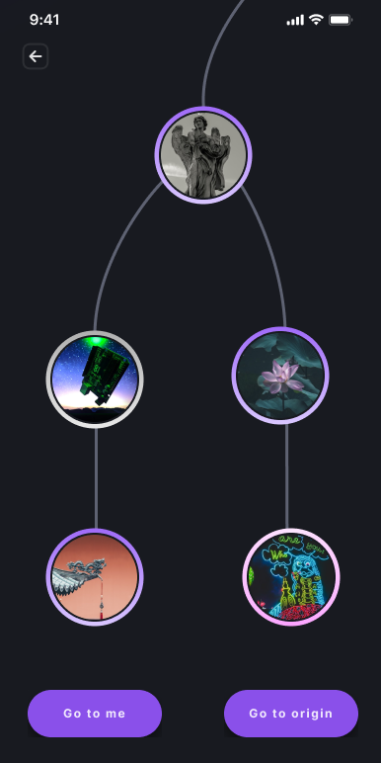
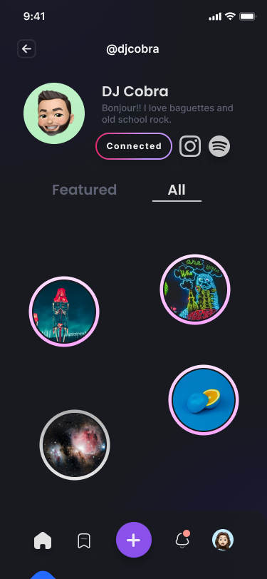
Tasks
Track additions to your soundbites and connect with “collaborator”
[COMPLEX]
Post a sound
[SIMPLE]
Add to a sound
[MODERATE]
Notes:
Moderate task revised: “add to” a soundbite instead of “reply to” a soundbite since we decided on the “train” soundbite idea over the “duetting” idea!

Slide 4
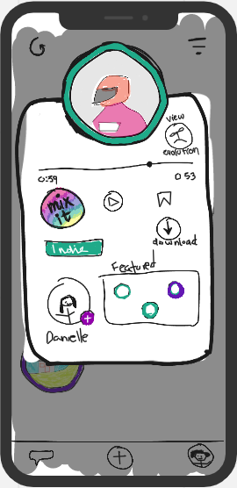
Major Design Change #1 Soundbite Pop-Up
Notes:
a. Major Design Changes - Present the 3 biggest changes between your low-fi sketches (from last week) and the new sketches of your updated interface. Show the before and after sketches and explain your rationale for making those changes.
b. Medium-Fi Prototype Task Flows - Present your 3 tasks as a series of storyboards of task flows (annotated screenshots from your medium-fi prototype, arrows between screens, etc.)

Slide 5
“Mix it” not intuitive
2/3 lofi testers were confused over “Mix it” meaning. We learned that “mix” meant something very specific in music production.
Unnecessary clutter
All lofi testers said the page’s contents were “overwhelming.”
Train idea → new needs
With new train idea, users would likely want to hear what leads up to their most current soundbite
Strange tag placement The genre tag placement was incredibly random in the lofi and didn’t make any logical sense, especially because it came after call to action buttons
“Add to Sound”
Changed the ultimate call to action button to “add to sound”
Delete “download”
Deleted “download” button because it was no longer needed with our novel soundbite ‘train’ idea
Hear ‘X’ last sounds
We redesigned the sound player to include the option to hear previous additions
Tag under cover pic
Moved the genre tag higher up, and added view evolution in a more aligned place.
Notes:
a. Major Design Changes - Present the 3 biggest changes between your low-fi sketches (from last week) and the new sketches of your updated interface. Show the before and after sketches and explain your rationale for making those changes.
b. Medium-Fi Prototype Task Flows - Present your 3 tasks as a series of storyboards of task flows (annotated screenshots from your medium-fi prototype, arrows between screens, etc.)

Slide 6
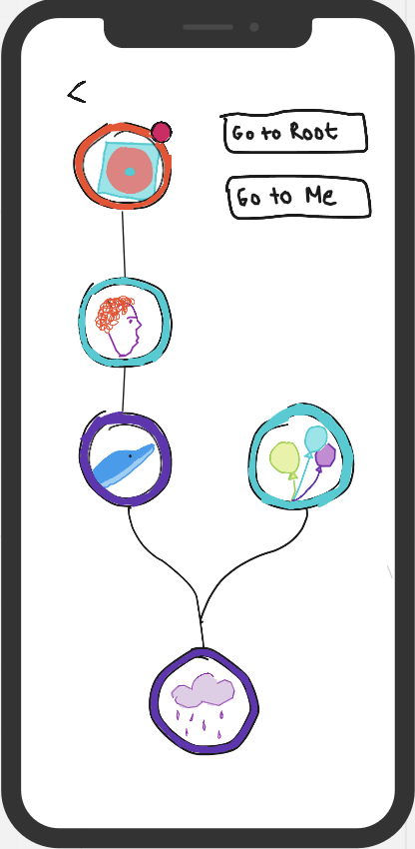
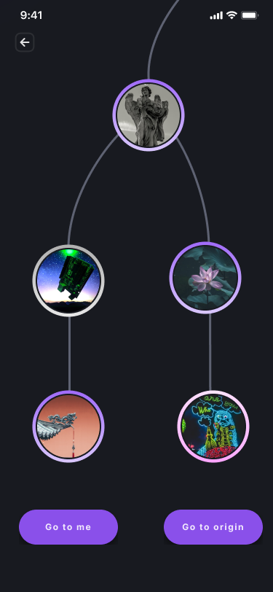
Major Design Change #2 Sound bite evolution page
Notes:
a. Major Design Changes - Present the 3 biggest changes between your low-fi sketches (from last week) and the new sketches of your updated interface. Show the before and after sketches and explain your rationale for making those changes.
b. Medium-Fi Prototype Task Flows - Present your 3 tasks as a series of storyboards of task flows (annotated screenshots from your medium-fi prototype, arrows between screens, etc.)

Slide 7
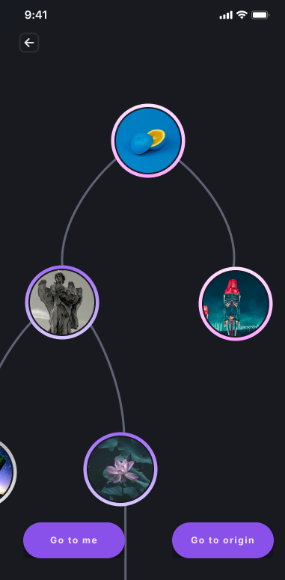
Bottom-up tree concept not intuitive
Many testers and classmates had trouble grasping this evolution screen, likely because it was more intuitive to understand as a timeline instead of a tree.
“Go to” buttons confusing
The buttons were intended to mean “go to original sound” and “your addition” respectively (in line with “Sprout” plant theme) but none of the lofi testers attempted to click the buttons because they didn’t understand the meaning.
Top-down redesign
Deviated from the “tree” idea and instead tried to make our design represent a timeline of chronological additions.
Rename “Go to” buttons
We renamed “Go To Root” to “Go To Origin” and “Go To Seed” to “Go To Me” and moved the buttons closer to the bottom for easier tap access.
Delete “Your Sound” bar
Since lofi users were confused about what they were for, especially since we had the “go to me” button.
Notes:
The page is scrollable to accommodate for different scales of evolution, and also so that the user can navigate to whichever section desired without too much cluttering.

Slide 8
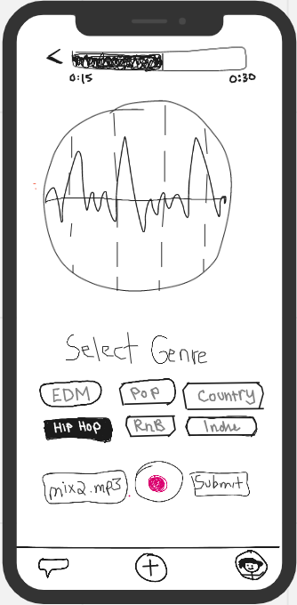
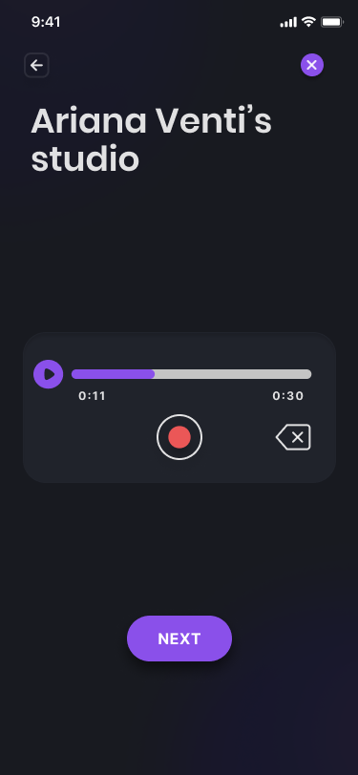
Major Design Change #3 Posting a Soundbite
Notes:
a. Major Design Changes - Present the 3 biggest changes between your low-fi sketches (from last week) and the new sketches of your updated interface. Show the before and after sketches and explain your rationale for making those changes.
b. Medium-Fi Prototype Task Flows - Present your 3 tasks as a series of storyboards of task flows (annotated screenshots from your medium-fi prototype, arrows between screens, etc.)

Slide 9
Sound frequency
The sound frequency was unnecessary and took up too much space
Select Genre
Select genre was above the record button so the users were confused if they were suppose to select the genre before or after recording. It also made the page too crowded.
Ability to re-record
The record button only lets the users record, but not delete what they recorded.
Better use of white space
We removed the unnecessary sound frequency UI, leaving more room for white space.
Divide and Conquer
To make the tasks less confusing we decided to break up each functionality into its own page, guided by a “next’ button.
Trash Option
Users get to delete what they recorded and start over with one tap.
Notes:
a. Major Design Changes - Present the 3 biggest changes between your low-fi sketches (from last week) and the new sketches of your updated interface. Show the before and after sketches and explain your rationale for making those changes.
b. Medium-Fi Prototype Task Flows - Present your 3 tasks as a series of storyboards of task flows (annotated screenshots from your medium-fi prototype, arrows between screens, etc.)

Slide 10
Med-Fi Task Flows

Slide 11
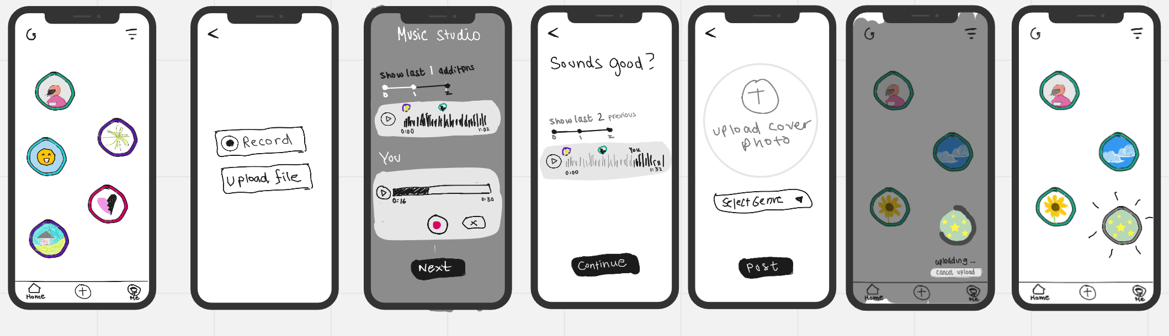
Post a soundbite (LOFI)
[SIMPLE]
Notes:
Sketch

Slide 12
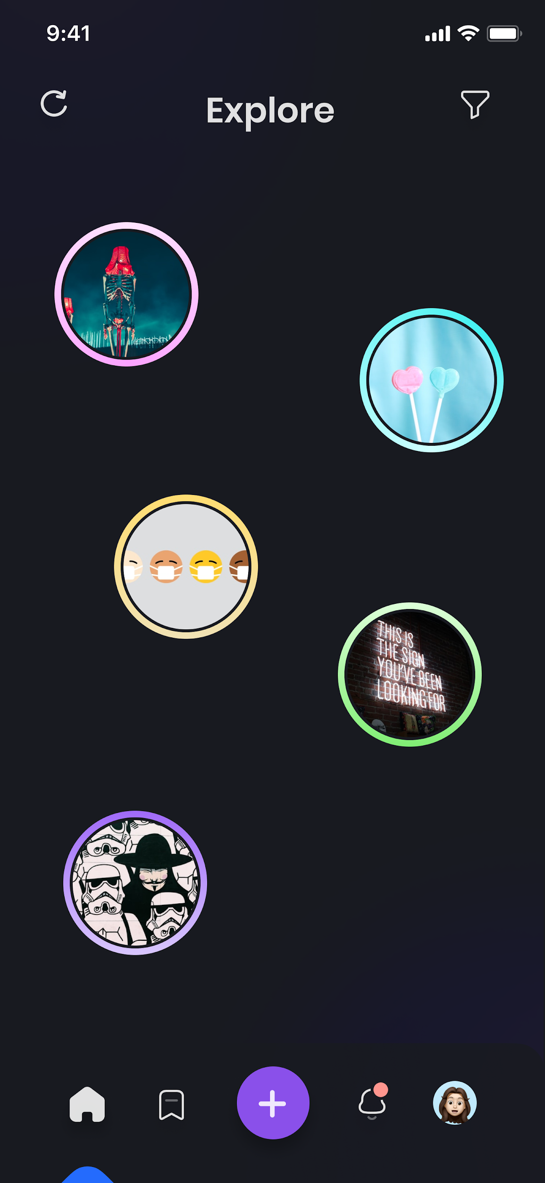
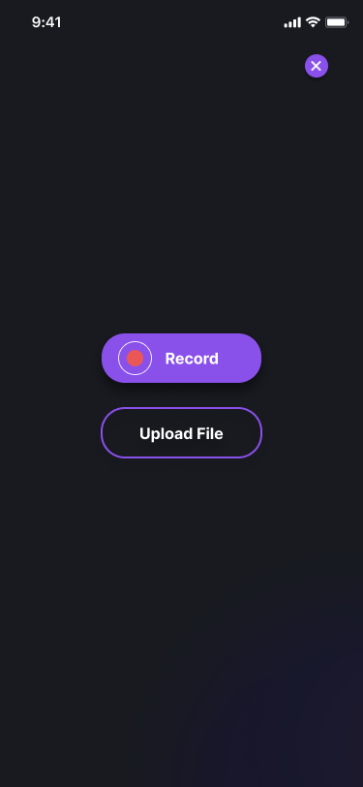
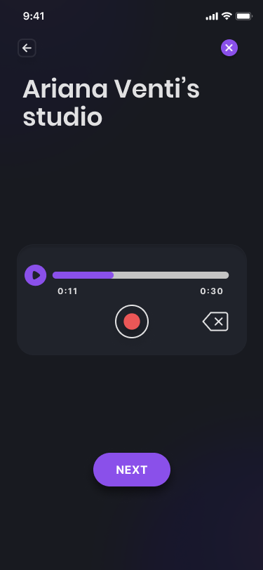
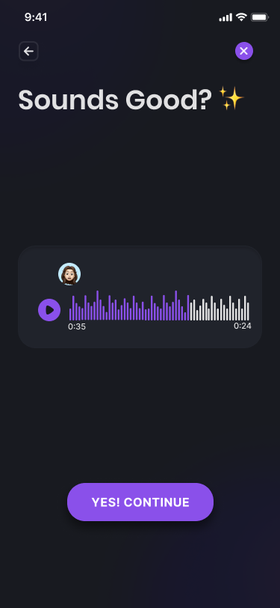
Post a soundbite
[SIMPLE]
Notes:
Prototype

Slide 13
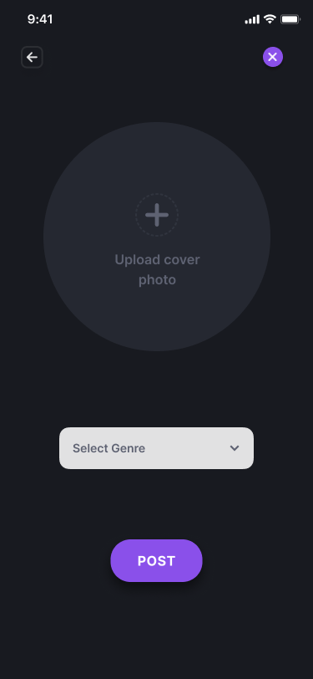
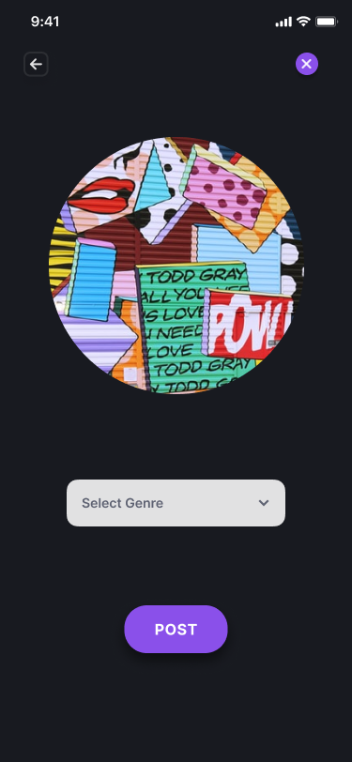
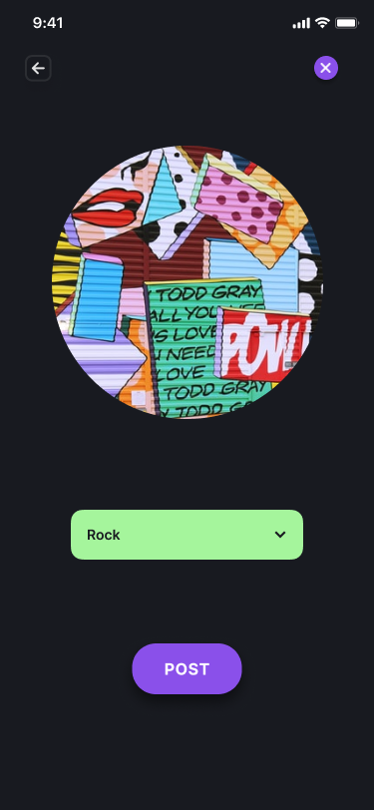
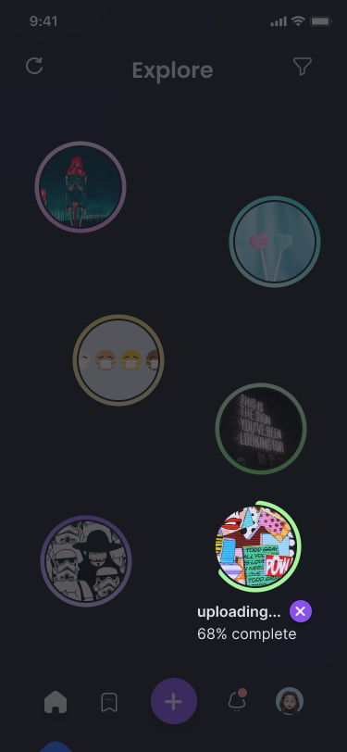
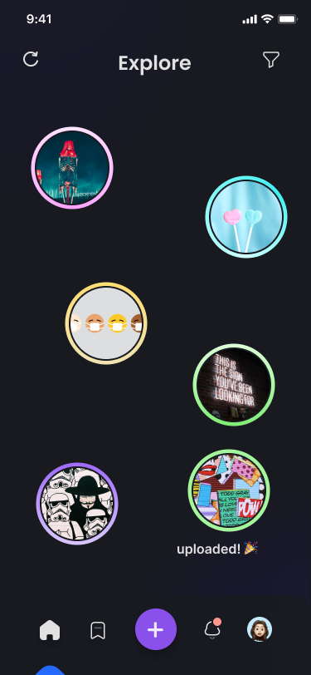
Post a soundbite
[SIMPLE]
Notes:
Prototype

Slide 14
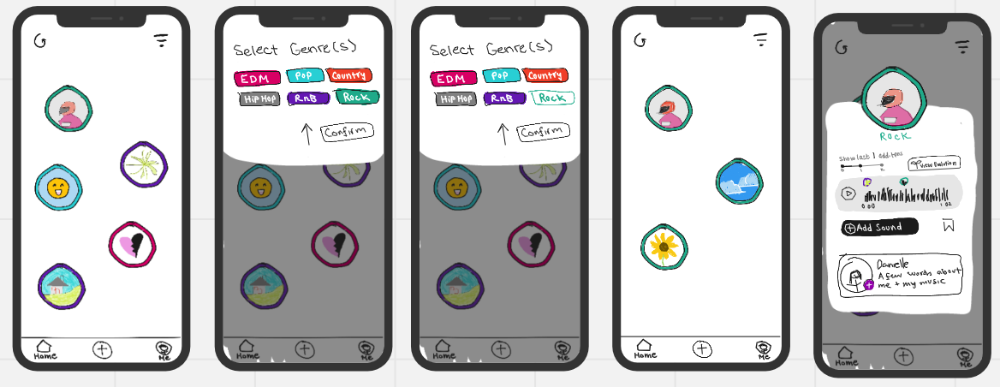
Add to a soundbite (LOFI)
[MODERATE]
Notes:
Sketch

Slide 15
Add to a soundbite (LOFI)
[MODERATE]
Notes:
Sketch

Slide 16
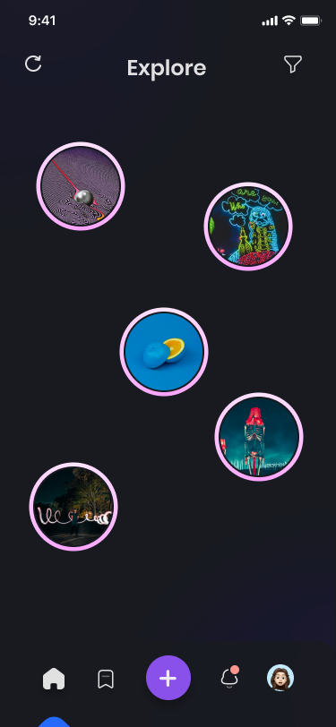
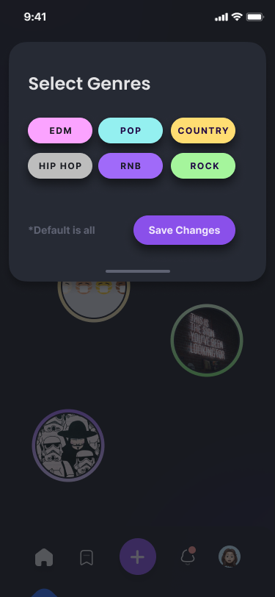
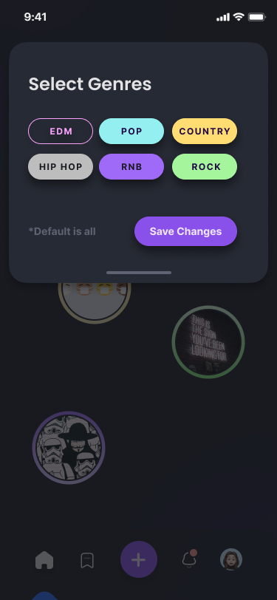
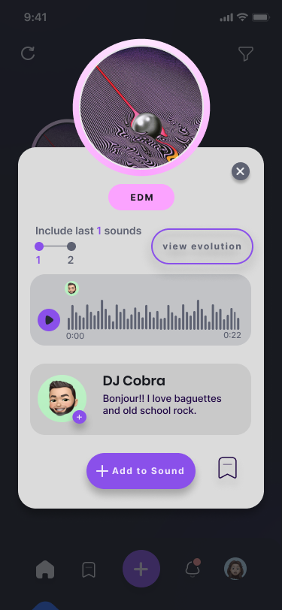
Add to a soundbite
[MODERATE]
[OPTIONAL]
[OPTIONAL]
[OPTIONAL]
Notes:
User has the choice to filter the soundbite bubbles by genre, but this is not a required step in the task. Notice that this task is now “add to a soundbite” instead of “reply to a soundbite” to reflect our decision of the “train” idea.

Slide 17

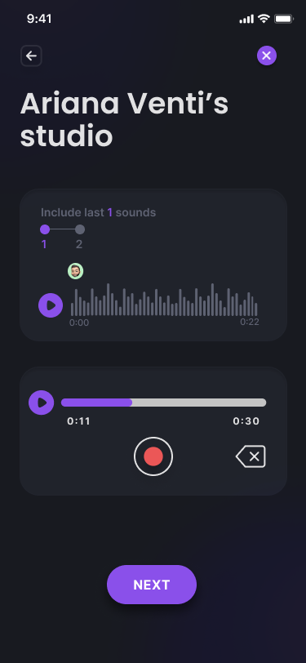
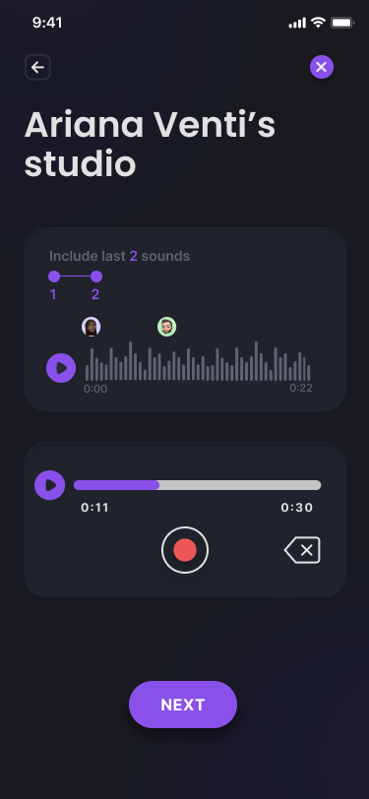
Add to a soundbite
[MODERATE]
*SAME AS ‘POST A SOUNDBITE’ TASK EXCEPT PLAYBACK AVAILABLE

Slide 18
Add to a soundbite
[MODERATE]
*SAME AS SECOND HALF OF ‘POST A SOUNDBITE’

Slide 19
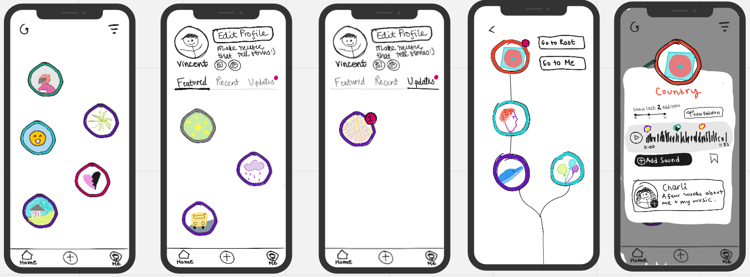
Track additions to your soundbites & connect with a remixer (LOFI)
[COMPLEX]
Notes:
Sketch

Slide 20
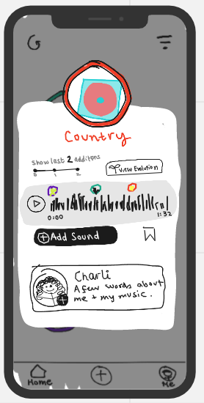
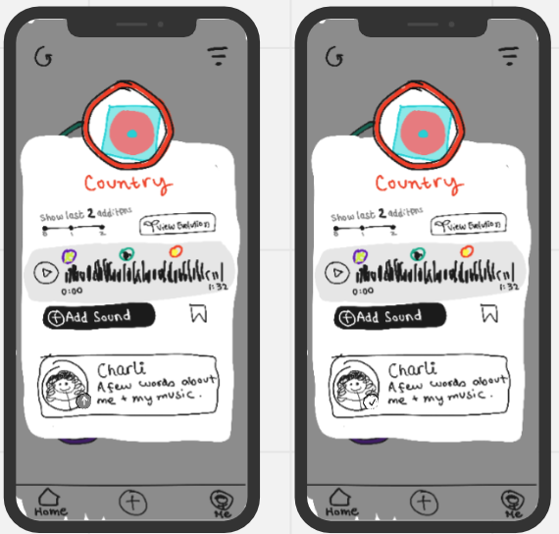
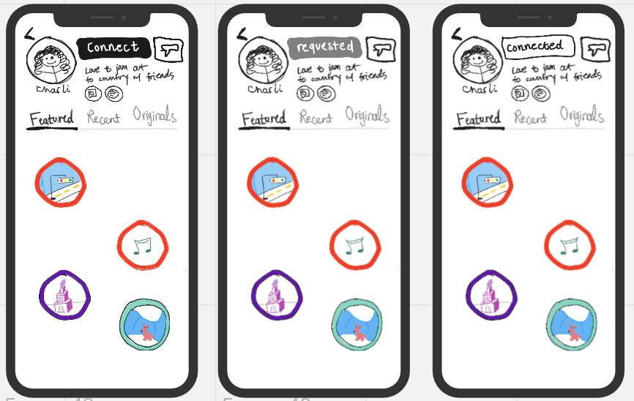
Track additions to your soundbites & connect with a remixer (LOFI)
[COMPLEX]
Notes:
Sketch

Slide 21

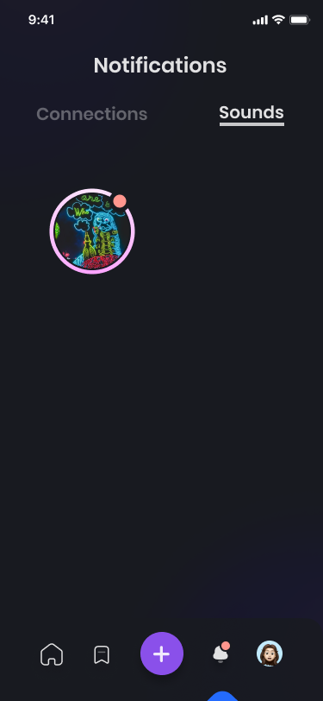
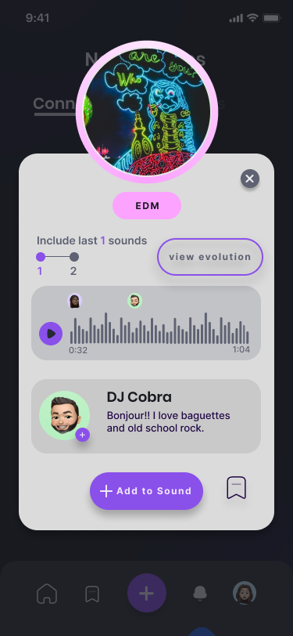
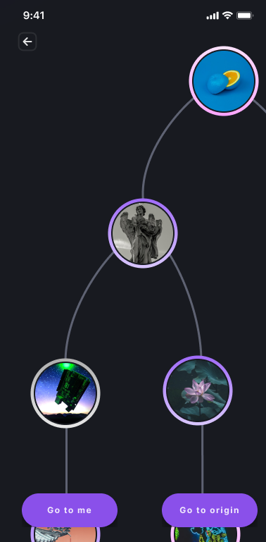
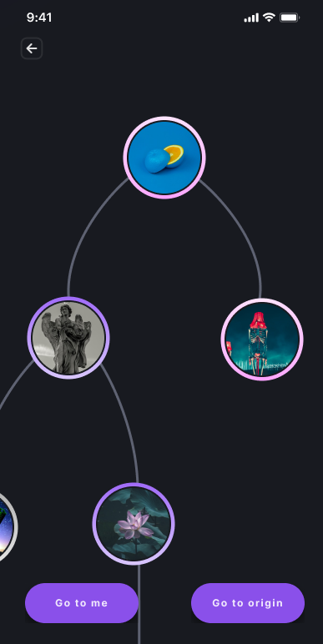
Track additions to your soundbites & connect with a remixer
[COMPLEX]
Notes:
Evolution page is scrollable

Slide 22
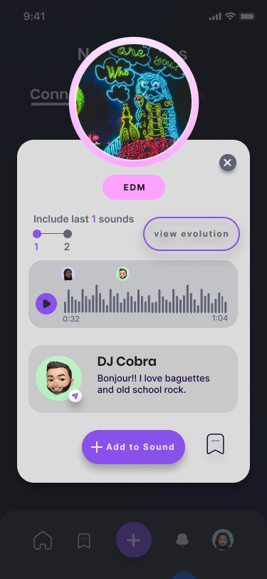
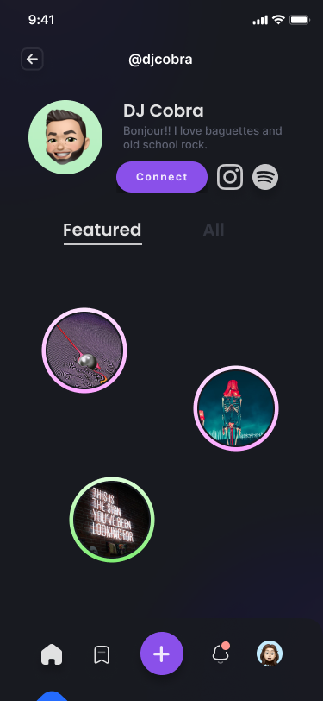
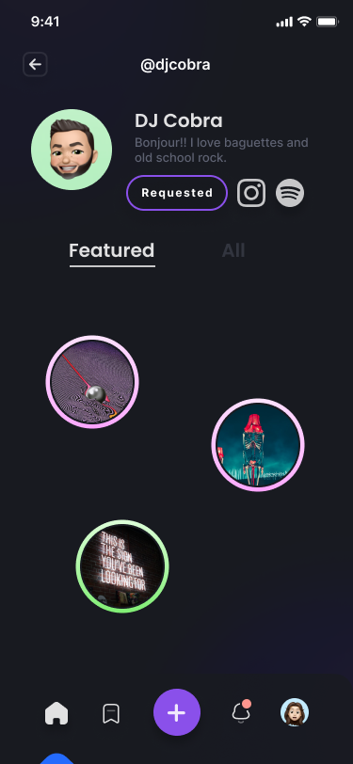
Track additions to your soundbites & connect with a remixer
[COMPLEX]
[METHOD 1]
[METHOD 2]
[ONCE USER ACCEPTS]

Slide 23


Design/Prototyping Tools
Pros:
Figma and Miro both offered collaborative environments for development which let all of us as a team work together efficiently. All applications had snap-in-place grid systems which made alignment easier. Figma’s component feature also helped with the DRY (Don’t Repeat Yourself) process.
[Designing components and prototyping]
Cons:
There was a steep learning curve to using both applications, especially Figma. However, once we got deeper into the development, we became more comfortable with the process.
[Mapping out task flows and brainstorms]

Slide 24
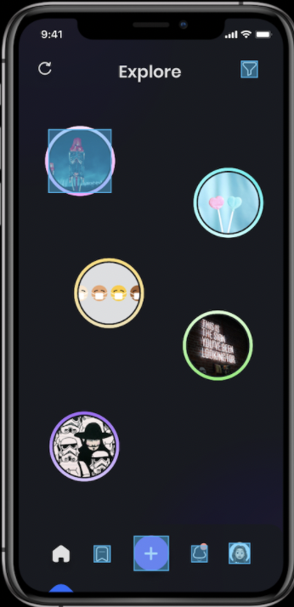
Limitations/Tradeoffs
Not all soundbites and buttons are clickable due to the numerous permutations and different screens we would have to design.
Users were unable to upload their own musical creations. Instead, they had to step into a simulated experience with certain hardcoded soundbites.
In addition, we don’t have a way to play the audio from a soundbite yet; however, the ability to toggle between the previous ‘x’ last sounds is possible.
[Only the top left (pink) soundbite is clickable]
[User cannot play audio of soundbite]
Notes:
(what was left out of the prototype & why)

Slide 25
Wizard of Oz
Wizard of Oz: When the user clicks “upload file” or “record”, the interface skips to an already uploaded soundbite on the next screen, instead of allowing the user to actually select a file from an upload pop-up or record their own soundbite. This is because all phones (Android, iOS, etc.) have unique files in their system and different upload processes based on their operating system (Android, iOS, etc.).
Hard-Coded Features: We currently have no real users or database to store user uploads and provided information about each soundbite. Thus, we hard-coded everything related to the soundbite (itself, pop-up page, updates tree, sound playback util), as well as their “user-provided” information (creator, cover photo, genre, etc.). We also hard-coded filtering options, as it any be too complex to allow users to submit/tag their soundbites with any genre they desire.

Slide 26
Figma Med-Fi
Prototype Link

Slide 27

Additional prototype screenshots

Slide 28
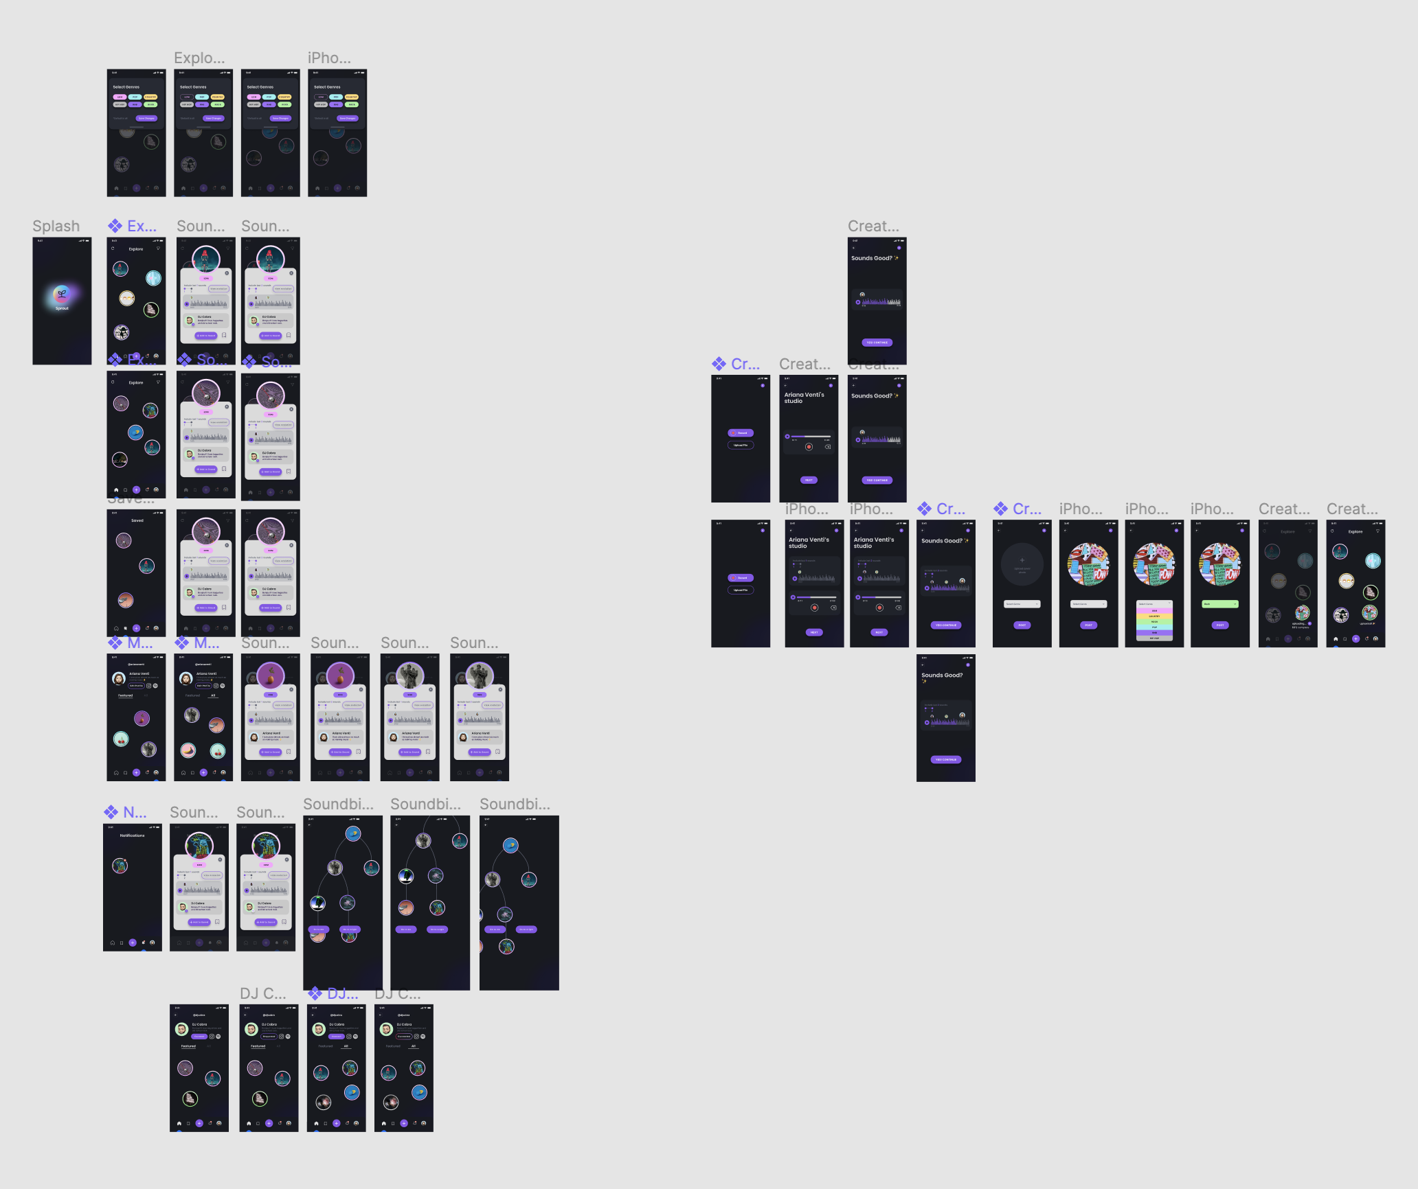

Slide 29
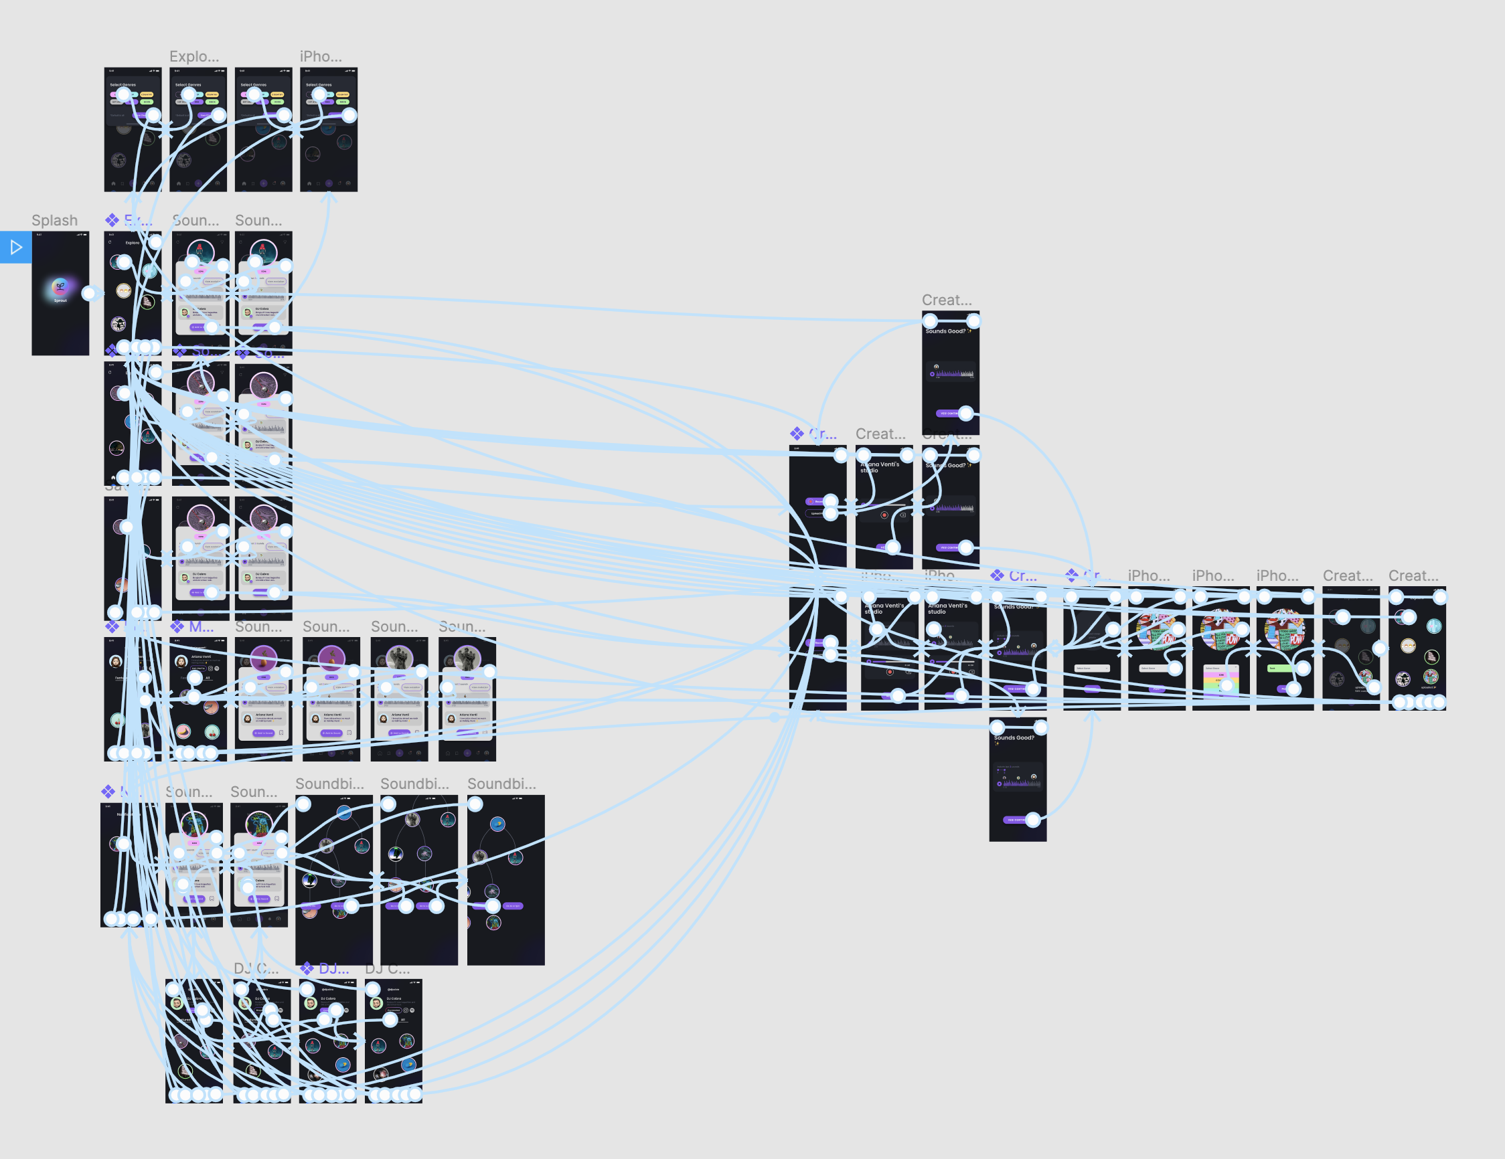

Slide 30
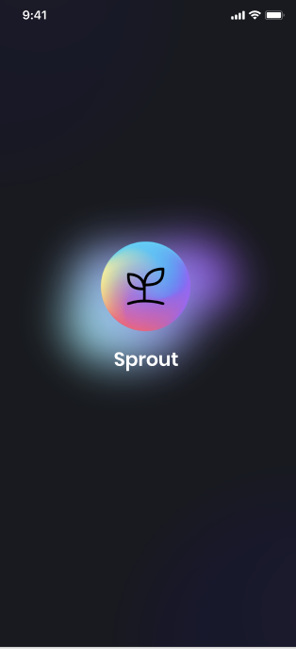
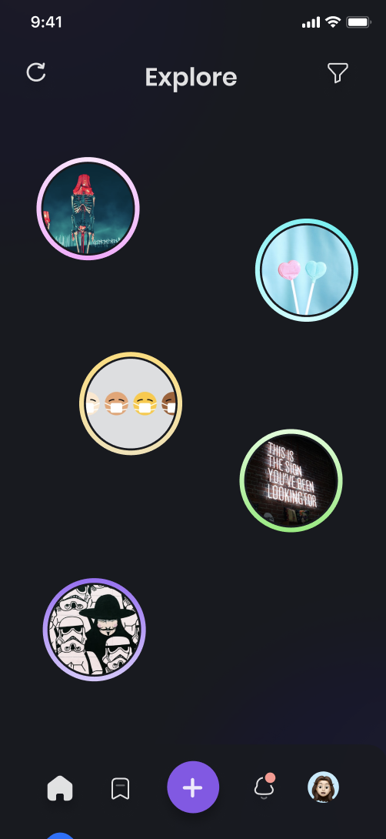
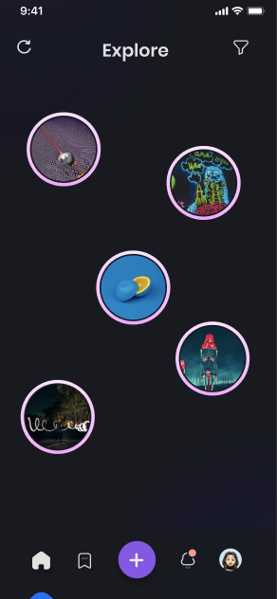
Splash Screen & Explore Page

Slide 31
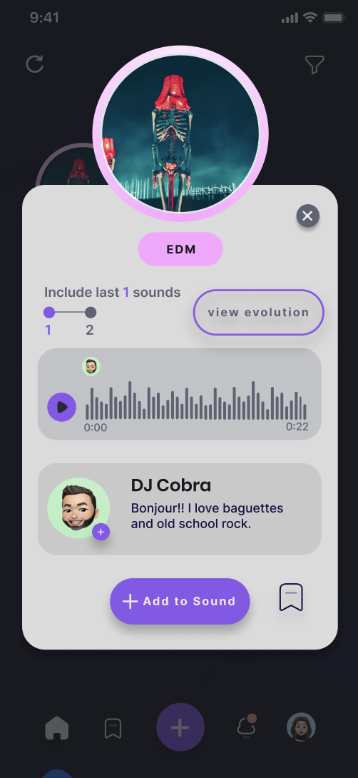
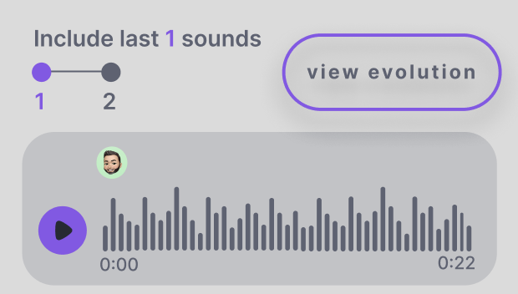
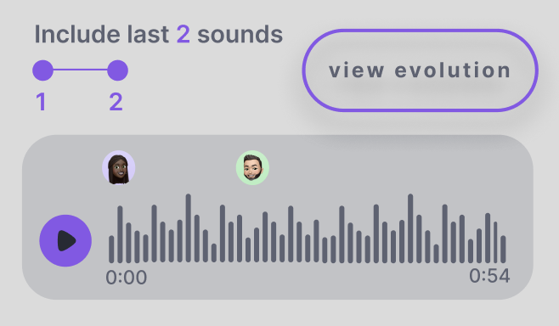
Sound pop-up
Enables playback listening, important for musicians when adding to sound.

Slide 32

Saved soundbites

Slide 33


User Profile:
Allow the users to scroll through their soundbites

Slide 34


Notification:
Separated soundbite updates from connect requests for easy viewing; sounds with new updates are indicated with a red dot

Slide 35


Connect with other user:
The newest contributor’s profile is displayed on soundbite pop-up; can send connect request using the + button

Slide 36


Connect with other user (alternative method):
Navigate to user profile and send connect request from there

Slide 37

Evolution
(with scroll to reduce cluttering)
Root
ME
“Go to me” view
Initial view
“Go to origin” view

Slide 38
Appendix Links
Miro Workspace
Updated sketches
Fimga
Prototype Designs

